Slide 1
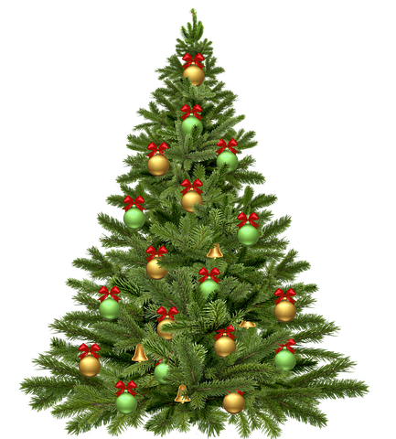
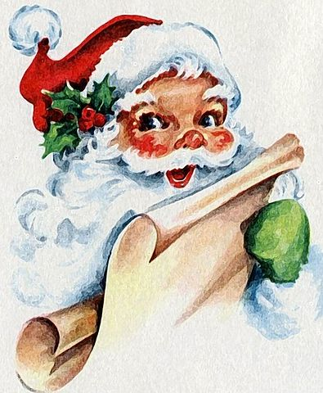
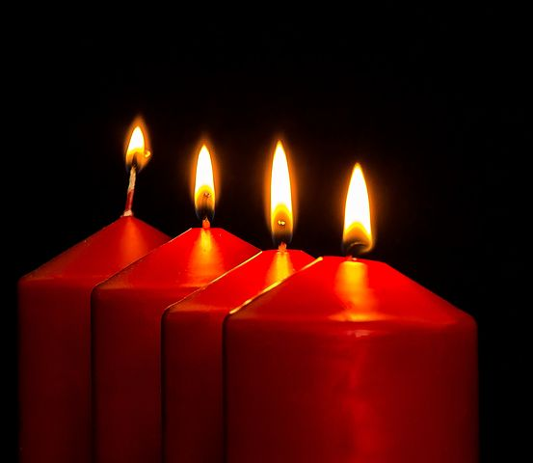

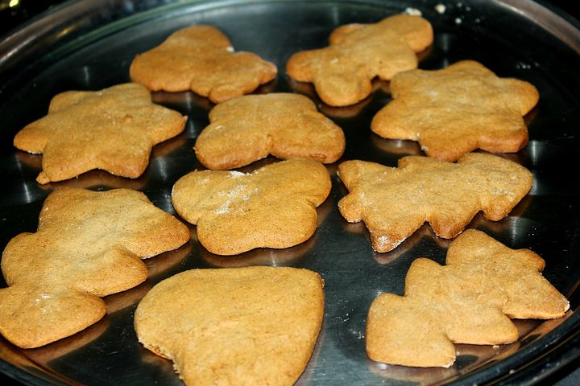
Santa Claus/ Julenisse
Christmas tree/ juletre
Red/ Rød
Gingerbread/
Pepperkake
Candle/ lys
Santa hat/Nisselue

Slide 2
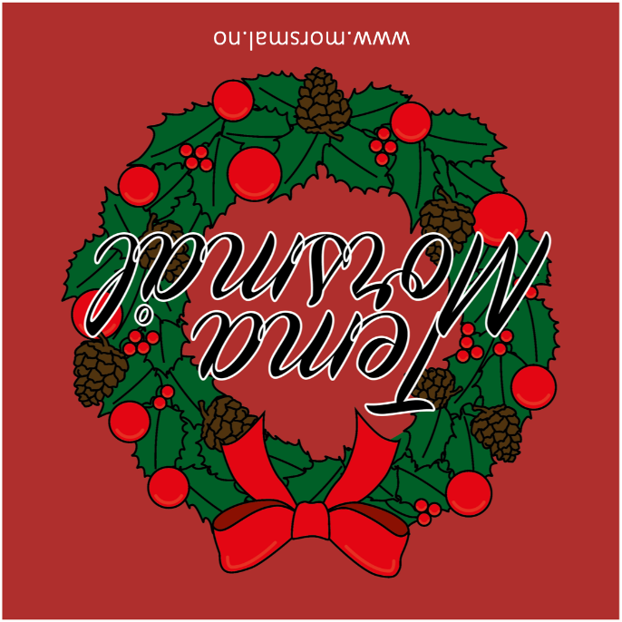

Slide 3
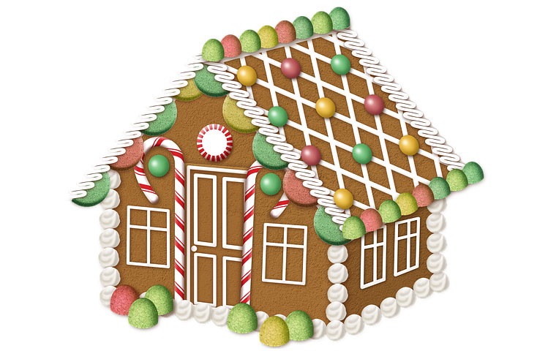

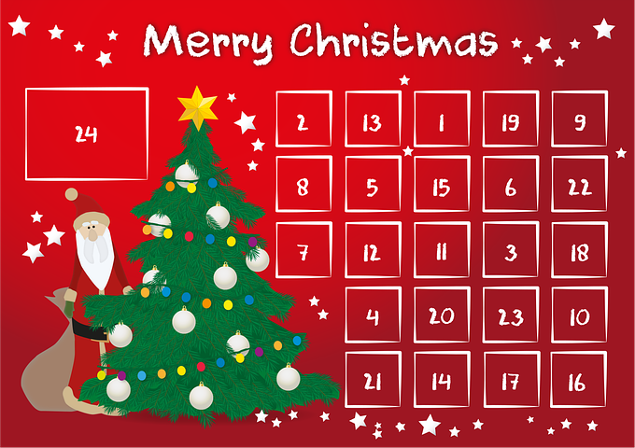

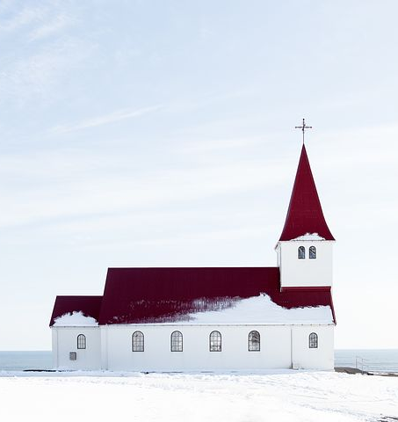
Gingerbread house/
pepperkakehus
Christmas calendar/ Julekalender
Gift/ Gave
Star/ Stjerne
Church/kirke
Green/ Grønn

Slide 5
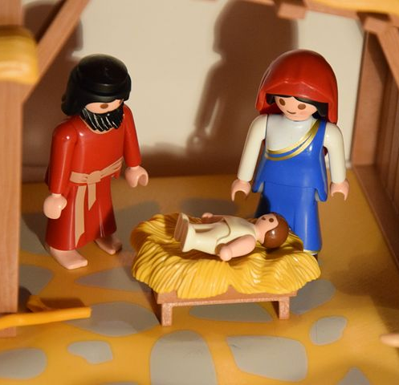
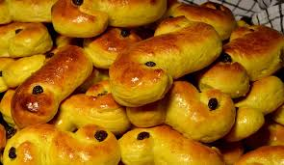
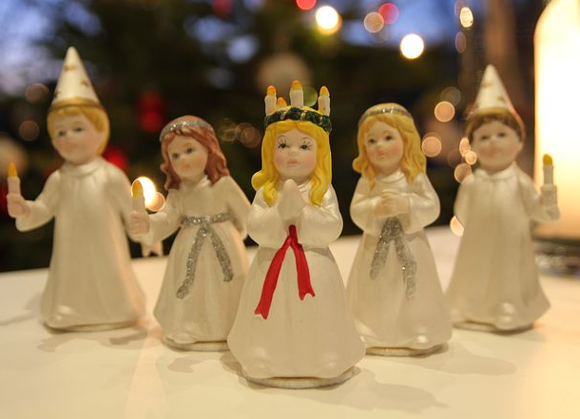

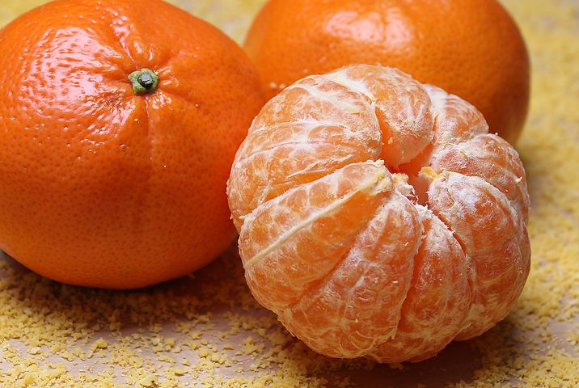
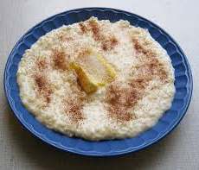
Saffron bun/
lussekatter
Lucia/ Lucia
Crib/ Krybbe
Clementines/
Klementiner
Campfire/Bål
Porridge/ Grøt

Slide 7


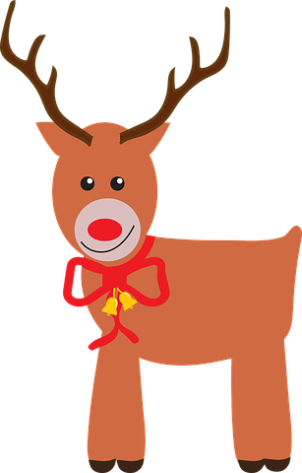
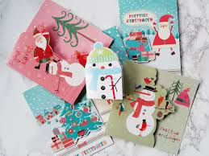
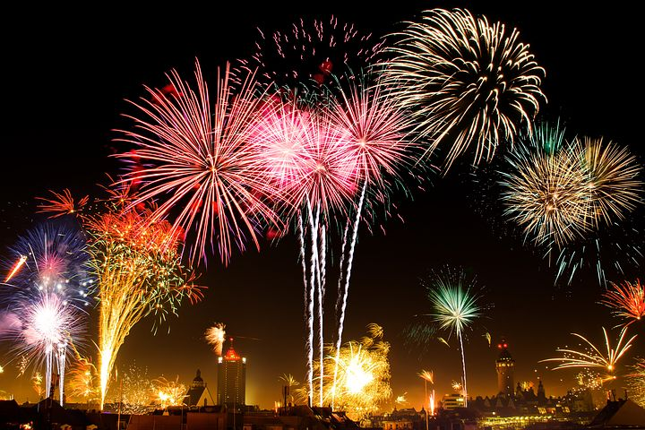
Sleigh/Slede
Purple/ Lilla
Rolling pin/Kjevle
Christmas card/ Julekort
Fire works/ Fyrverkeri
Reindeer/Reinsdyr

Slide 9

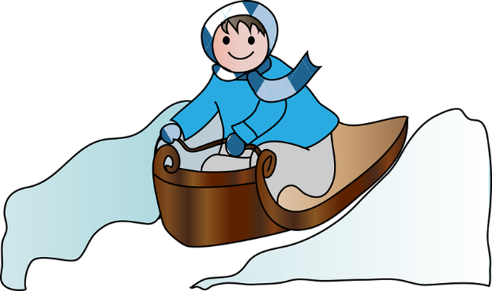
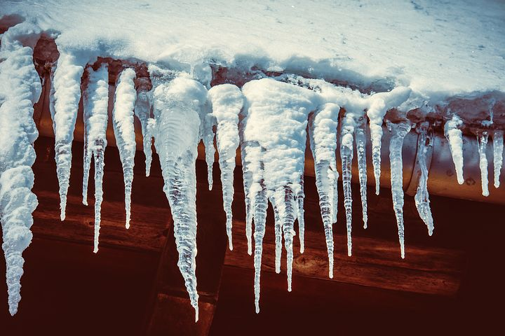
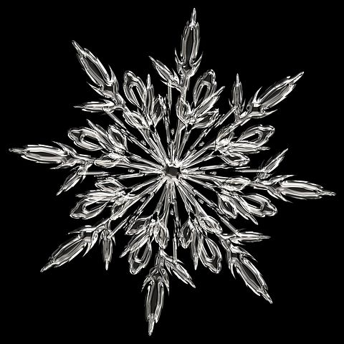

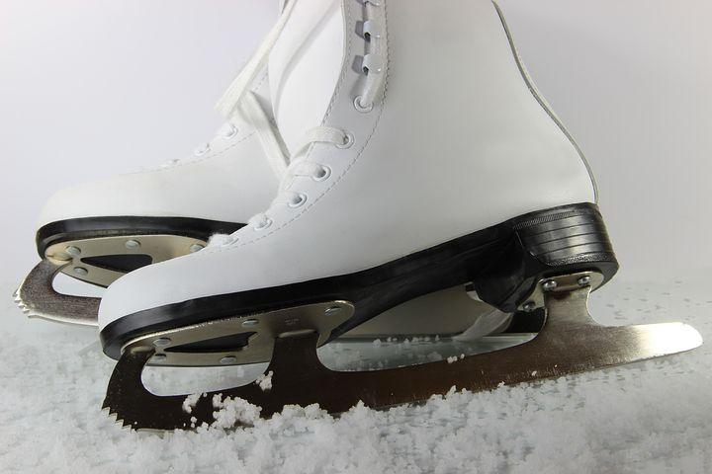
Sledges/ Akebrett
Icicle/ Istapp
Snowman/ Snømann
Iceskates/ isskøyter
Snow crystal/Snøkrystall
Ski/ Ski

