Slide 1
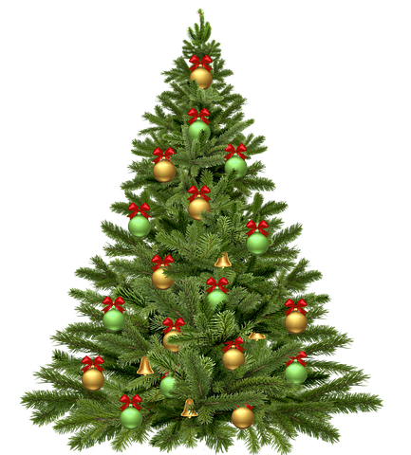
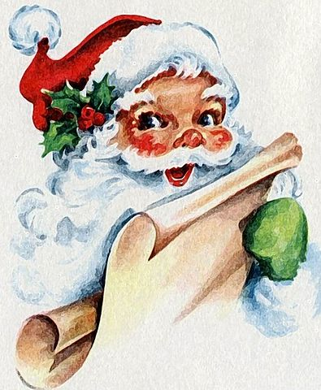
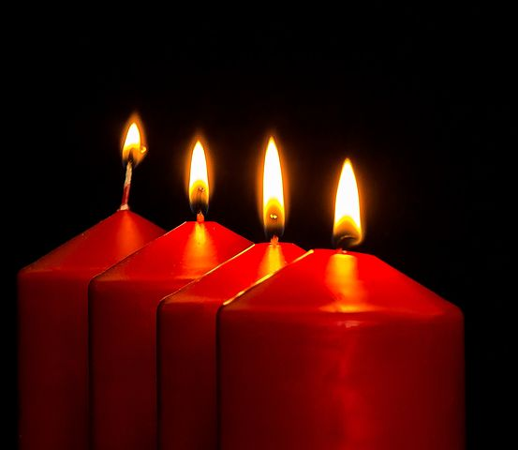

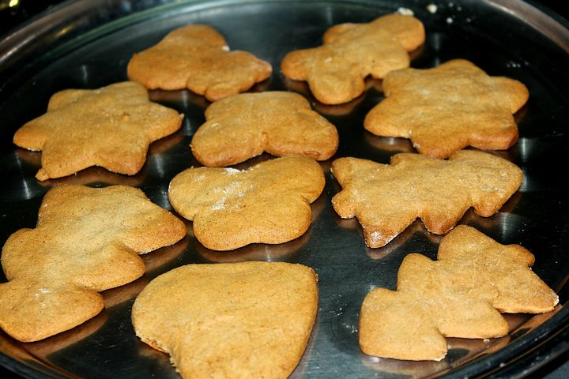
Geedka ciida masiixiga/ Juletre
Cas/ Rød
Santa/Julenisse
Shumacyo /Lys
Koofiyadda Santa/Nisselue
Buskut-xawaaji/ Pepperkake

Slide 2
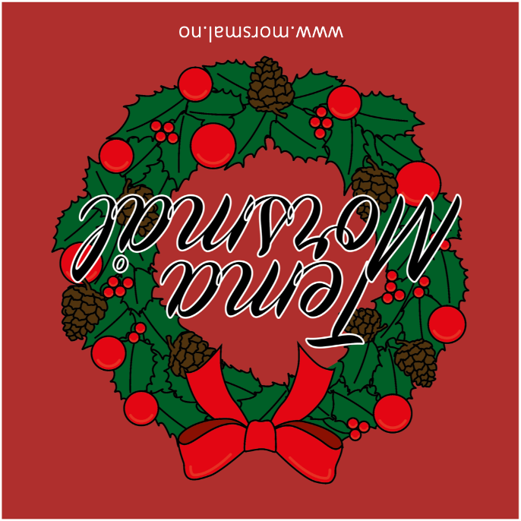

Slide 3
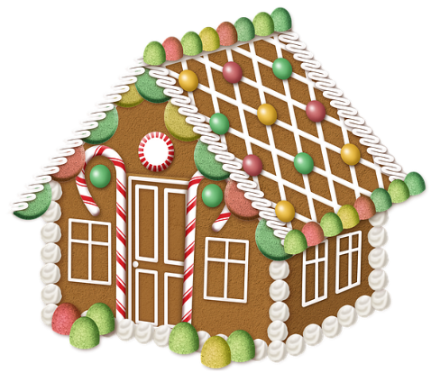

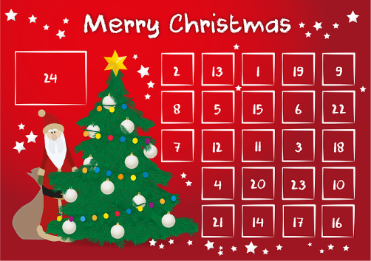

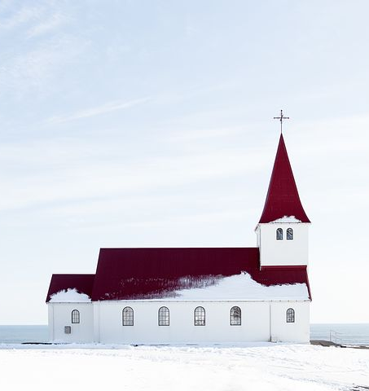
Guriga buskut-xawaaji /
pepperkakehus
Calendar Christmas/
Julekalender
Hadiyad/Gave
Xiddig/Stjerne
Cagaar/Grønn
Kaniisad/kirke

Slide 5
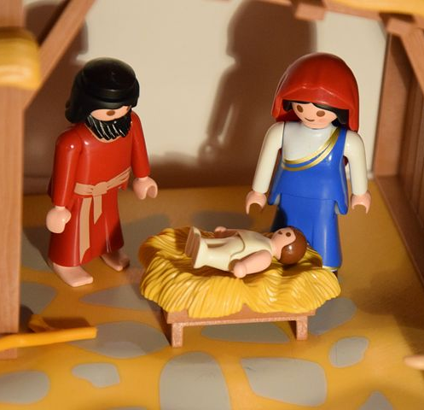
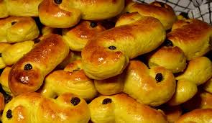
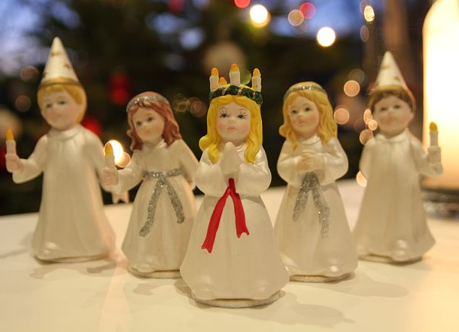

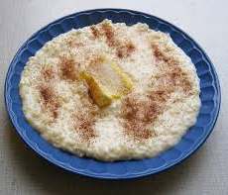
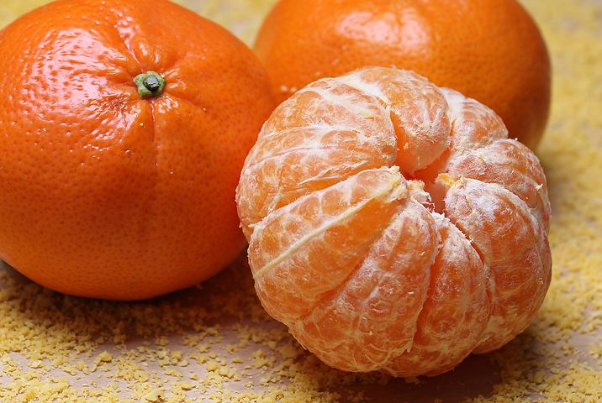
Bunni saffron/ Lussekatter
Sariir / Krybbe
Lucia/Lucia
Liin-macaan/ Klementiner
Dabshid/Bål
Boorash/ Grøt

Slide 7


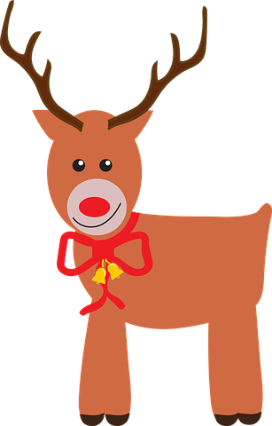
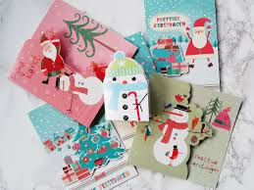
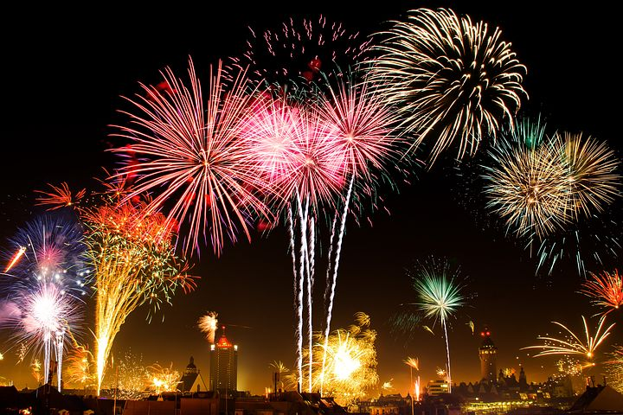
Gawadhi /Slede
Kasha wax lagu fidiyo /Kjevle
Barbelka / Lilla
Kaararka kirismaska/ Julekort
Baaruud / Fyrverkeri
Deerada /Reinsdyr

Slide 9

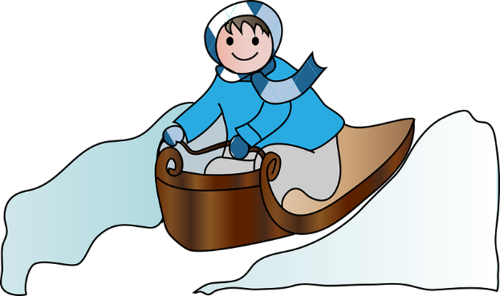
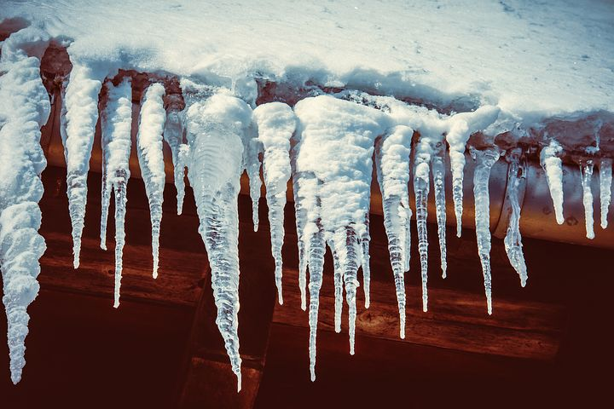
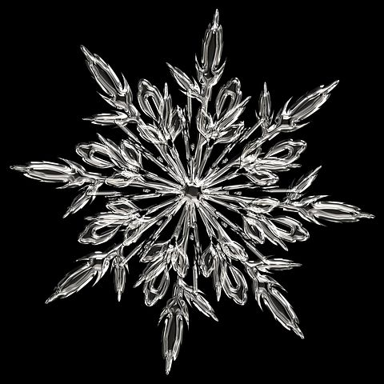
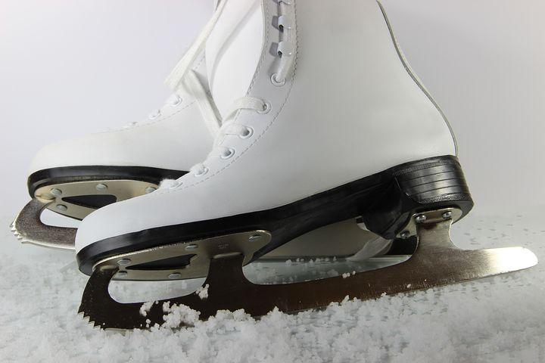

Gaari / Akebrett
baraf ul u eg/ Istapp
Snowman / Snømann
Baraf ku sabiibixasha/
Isskøyter
Baraf dhalaalaya/Snøkrystall
Barafka ku ciyaarid/ Ski

